Slide 1

Putting Privacy First: Making Due with Less Data
Jeremy Goldstein
Minuteman Library Network
jgoldstein@minlib.net
Notes:
This afternoon we’ve been sharing information on all the cool things that can be done with the data in our systems. Now I’m to be the bummer and talk a bit about why you may want to think twice about some of those efforts and provide some examples of ways to accomplish your organizational data needs while foregrounding the privacy of your patrons data.

Slide 2

Massachusetts Law
That part of the records of a public library which reveals the identity and intellectual pursuits of a person using such library shall not be a public record as defined by clause Twenty-sixth of section seven of chapter four.
-Massachusetts General Laws Chapter 78, Section 7
Notes:
Full disclosure up front, my perspective on these issues is coming from living in Massachusetts where I don’t know if you’ve heard but we’re pretty leftist. I’m personally represented in Congress by Elizabeth Warren and Katherine Clark and one of the cities within our consortia is the People’s Republic of Cambridge. That brings with it a certain baseline attitude to our practices that may not match with a lot of libraries elsewhere.
To start out, here we have the Mass. Law governing library data, which currently forms the basis for most library policies.

Slide 3
Policy Interpretation
This law extends to circulation records (borrowing records, registration records, reserves or fine records), information sought or received, materials consulted, interlibrary loan transactions, registration records, database search records, reference interviews, or any other personally identifiable uses of library materials, facilities or services of its patrons. In accordance with this law, the Somerville Public Library will not disclose or make available any circulation information, registration information, or information retrieval records in response to any inquiry except
To the cardholder (with library card or proper id). This applies regardless of age or relationship, and staff is therefore restricted from disclosing information to the parents of minors when the minor has their own library card;
To persons authorized by the cardholder to access the individual’s records by providing such persons with their physical library card or the card’s barcode scanned into their cell phone;
By library authorities acting within the scope of their duties for the purpose of interlibrary cooperation and coordination as authorized by M.G.L. c. 78, section 7; or
To representatives of any local, state, or federal government, pursuant to subpoena, order or search warrant authorized under the authority of federal, state, or local law relating to civil, criminal, or investigative power. Upon receipt of any such subpoena, order or search warrant, the library administration will consult with legal counsel to determine if it is proper to release the requested confidential information.
https://somervillepubliclibrary.org/library/policies/privacy-and-confidentiality/
Notes:
And here we have a portion of the privacy policy in place at the Somerville public library in our network. The key example here I’ve highlighted is the interpretation that the patron records of minors, dependents, absolutely anyone cannot be shared with their guardians in most cases…that interpretation of the law is held pretty broadly and prevents us from using fairly standard features of the ILS like linked patrons…no matter how much our patrons may actually want that. There are some allowances, generally if a parent is holding their child’s card it’s assumed the child has granted permission and staff don’t push back too much…but that level of record protection is the goal.

Slide 4
Massachusetts Data Privacy Act
Senate Bill S.2619 https://malegislature.gov/Bills/194/S2619
House Bill H.4746 https://malegislature.gov/Bills/194/H4746
Data minimization first approach to privacy
Limit Data Collection to what is:
Reasonably necessary to provide services
Strictly necessary for sensitive personal data
Greatly expands on what is considered sensitive data
Ensures consumers have rights to view, correct and delete their data
Sets new requirements and penalties for compliance
Notes:
That’s where we are now but currently we’re looking at a new privacy law that is likely to be passed, though we don’t know when it’ll happen or what the final form may ultimately be. These parallel bills have passed both chambers and currently waiting to be reconciled in the House Ways and Means Committee to start the reconciliation process. The House version is actually a bit more restrictive while I’ve focused more on the Senate draft.
These bills take a true data minimization forward approach to data privacy and greatly expand on the legal definition of sensitive data that may be legally covered, fully addressing items such as information that may reveal the intellectual pursuits of an individual…so you know reading history data. The law is written to explicitly exclude government entities, which likely does cover our public libraries…but not our academic members, the vendors we work with, or probably the consortia ourselves.

Slide 5
Minuteman Standards
5 Weeks Circ Transaction
Though we do use both libraryIQ and Decision Center
3 Months Fines Paid
3 months lpatron number in inactive items
5 years inactive patrons, including outstanding bills
Do not use linked patron feature
Do not use masquerade mode in Aspen
Removed gender field
Many libraries omit birth dates
It was discussed if we really need addresses
We do
Notes:
In Minuteman we’ve always tended to veer towards restricting data, especially from the institution of the Patriot Act onwards, and then more recent events have only led to emphasizing these sorts of practices further. We only keep about a months worth of circ transaction data around, clear out old fines data regularly, when we purge inactive patrons after 5 years we also clear out any outstanding bills at that point, we removed gender information from patron records entirely, birth date is purely optional and is essentially useless date given how unreliable that data is across records now. Recently a few directors considered removing addresses entirely…but thankfully that proposal was rejected…you get the idea.

Slide 6
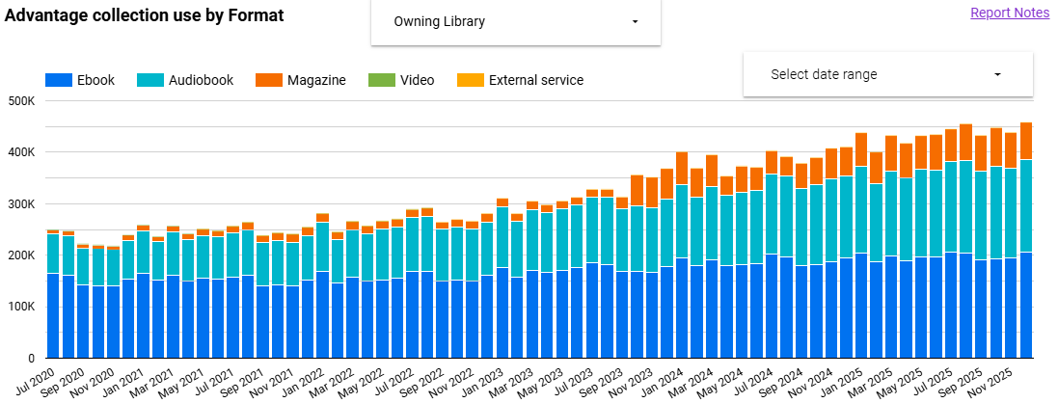
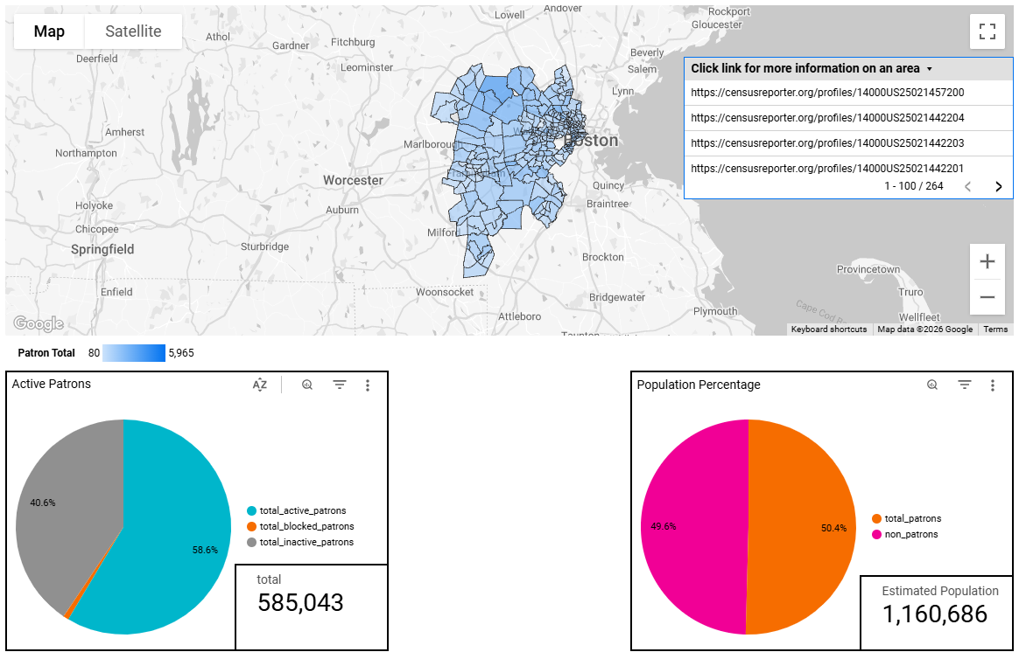
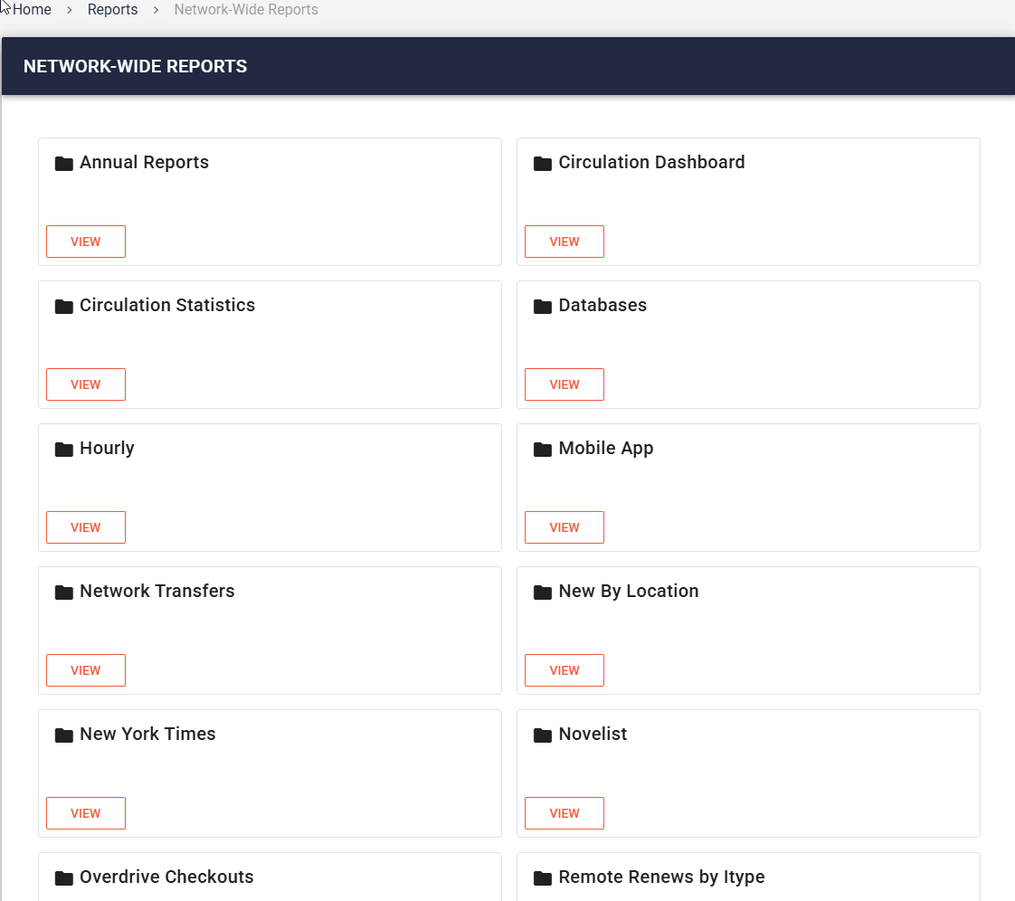
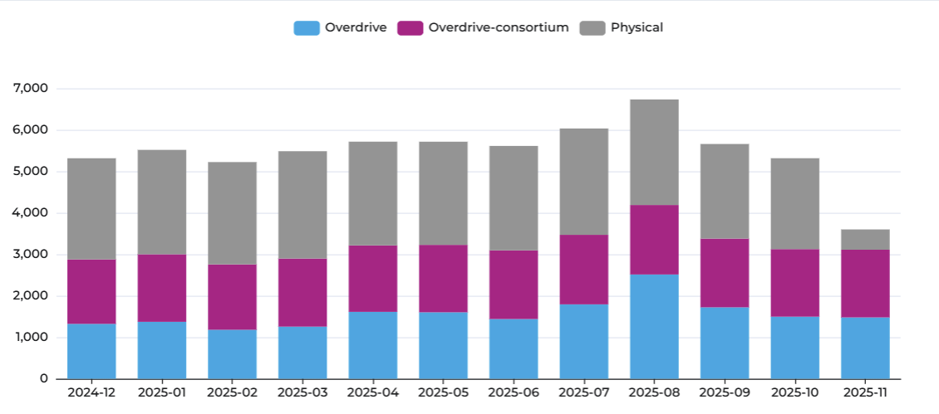
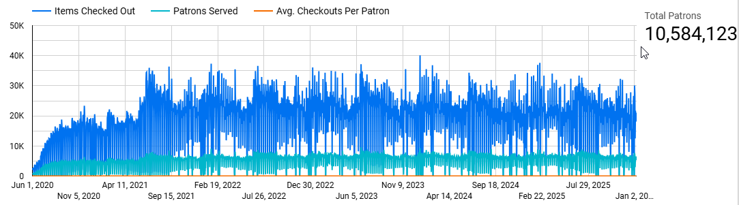
And Yet...Data
Notes:
And yet we still have data….lots of data…and lots of reporting options to go with that information…so let’s get into how we try to strike the balance between our two conflicting needs.

Slide 7
Approach
Data Minimization
Store the bare minimum long term
Aggregate what we can
Avoid patron details as much as possible
Access Minimization
Report tools separate user access from raw data
Limit third party access to everything
Notes:
We mainly try to follow some security basics. Minimize the data we store to what’s essential and limit who has access to that data where we can. When we store data outside the system we do so in aggregate form, just counts of transactions by various combinations of fields. And really try to eliminate as much patron information as we possibly can, though it’s not always possible especially when it comes to working with some third parties.
On the access front the reporting tools we create provide end users data views through canned sql reports and dashboards that generally keep them at a remove from the raw data. No one outside the admins at our consortia office have sql access and we are very cautious with API keys we may give out. For third parties such as libraryIQ that we work heavily with, and I quite literally work for as a contractor in the interest of full disclosure, we send them daily extracts of the data they need as opposed to providing them their own access to our instance of Sierra.

Slide 8
What We Can’t Answer
How many times did a patron come to the library in the last year?
Which patrons have been the heaviest users of our hotspots?
Which patron checked out a particular item, 2 checkouts ago?
* What was the most checked out title of 2025?
Notes:
Because of our limited data, there are data requests that come through regularly that we can’t actually answer or can’t answer exactly. For the remainder of my time here I’m going to review of few of these to show some how we may address some of these scenarios

Slide 9
How many times did a patron come to the library in the last year?
Lack the transaction history to pick out individual days when the patron recorded a transaction
Transaction aren’t everything, system never records online use, program attendance, etc.
Notes:
To start off with, how many times did a patron come to the library in the last year? Because our transaction history only goes back 5 weeks and because patron records don’t have a field for counting this sort of information there simply isn’t data to work with…but even if there were that still wouldn’t tell the whole story about a given patron’s usage of the library. Things like program attendance never get recorded so there are many cases when a patron may visit the library that the system would never know about.

Slide 10
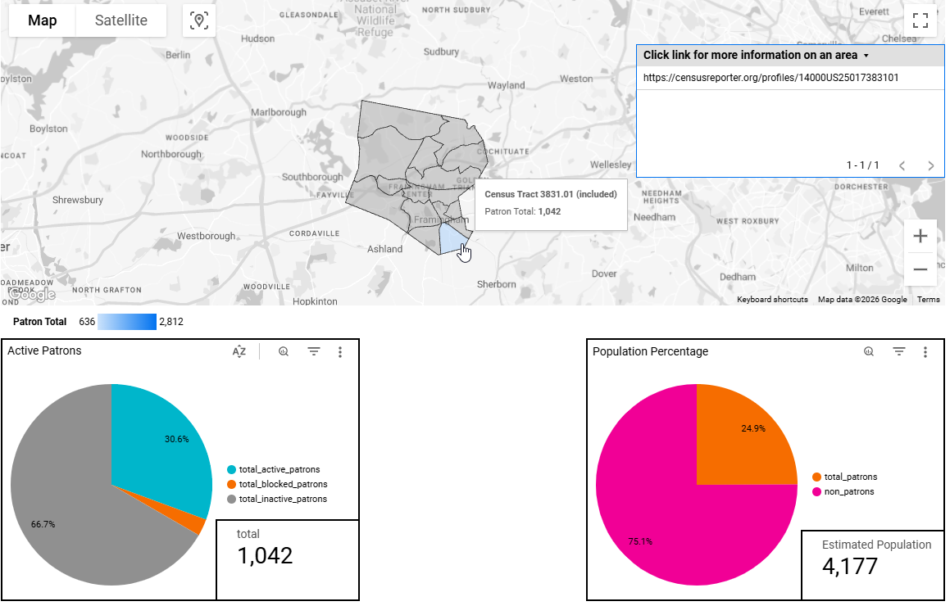
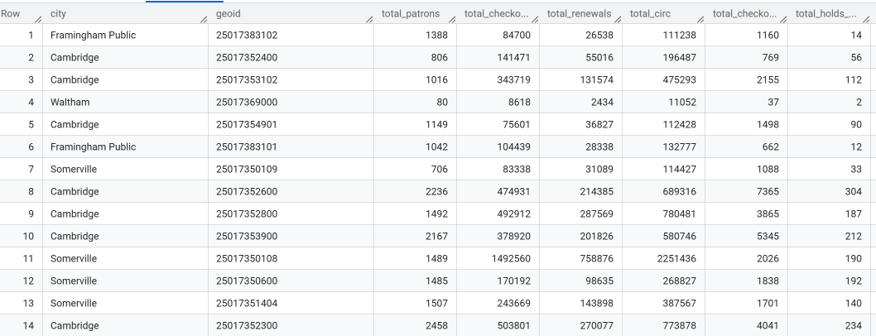
What We Can Answer Instead
Which communities are we succeeding/failing to serve?
Notes:
So we can’t gather data on individuals…but that micro level of information isn’t actually that useful anyway…unless you’re doing something like targeted marketing I suppose and we don’t have time to get into that. So instead let’s look at what can be accomplished with the macro view of patron activity.
Here’s the patron map some of you may have seen earlier if you came to my speed geeking session. This provides tons of valuable data on which neighborhoods are using the library and which aren’t. Staff have a useful and intuitive interface for exploring the data, that’s locked down easily to people with a valid email in our domain…just using Google accounts essentially the same as sharing a doc, while not having direct access to the underlying database…not that there’s anything particularly harmful for them to access in this table. We’re not exposing names, addresses, record numbers, anything that could be remotely considered sensitive information. The aggregate data here is far more meaningful than the granular data about individuals

Slide 11
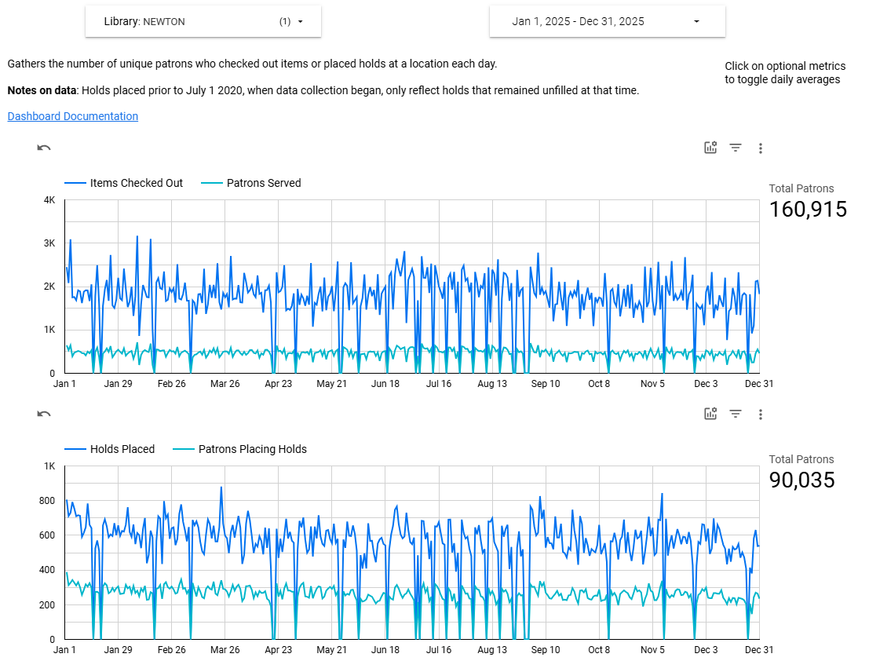
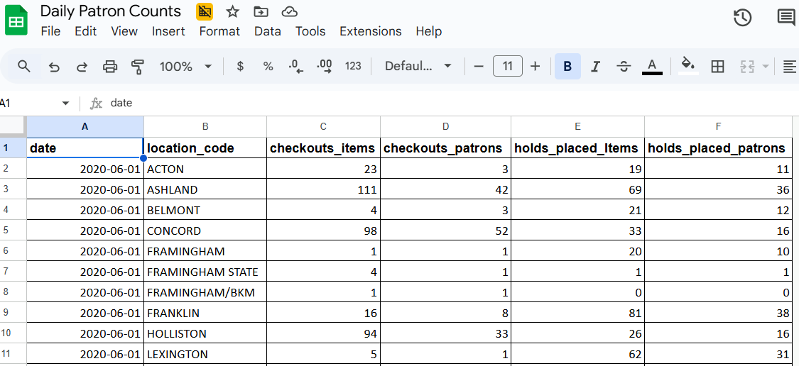
What We Can Answer Instead
How many individuals checked out at the library each day?
Notes:
For something that could be more sensitive in nature if you’re not aggregating, here’s a dashboard providing the daily count of unique patrons who used every one of our locations going back to the early pandemic. To gather up unique users counts, you need to actually look at record identifiers, barcodes or record numbers, PII where we really don’t want to retain a record of an individual’s usage patterns. So instead we’re just taking the daily aggregate total for each location and storing that. There are tradeoffs with this of course, I can’t use this data for different timeframes to say how many unique individuals used the library in a week, how many used the library multiple times in a month, any of that. Nice things to do but also those answer questions that we generally aren’t being asked. So we’ve got minimum viable data here that works for the primary use case staff have, how busy does the desk get.

Slide 12
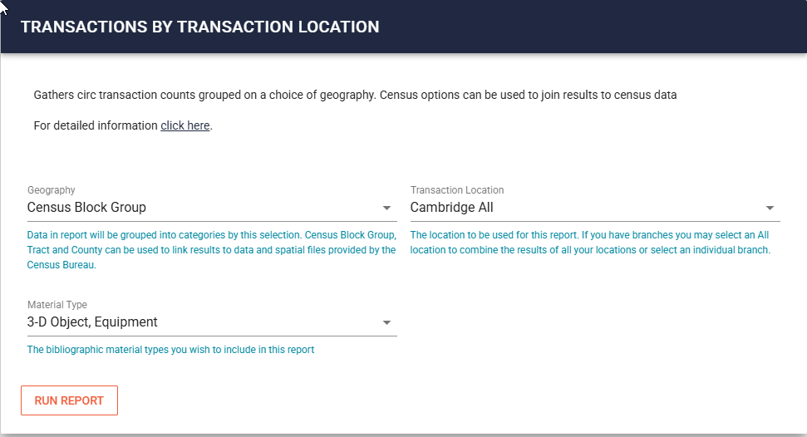
Which Patrons Are the Heaviest Users of Our Hotspots?
Which locations should have the most inventory given hotspots are not placed in delivery?
How can we track usage patterns without storing reading history?
Notes:
This question came to me recently from the Cambridge library where they have a number of branches and were interested in finding a way to calculate how they should distribute their hotspots among them to best pair their inventory with the interested population given that the hotspots are not sent out through delivery.
Aggregate data to the rescue. We’ve already seen a map of cardholders, that’s possible because we’ve been geocoding our patrons records, which allow us to aggregate patrons at a number of geographic levels from the not terribly informative (county, nearly all our patrons live in one of two) to the extremely granular (census block groups). This allows us to anonymize activity while still being able to pinpoint fairly narrow portions of our community.

Slide 13
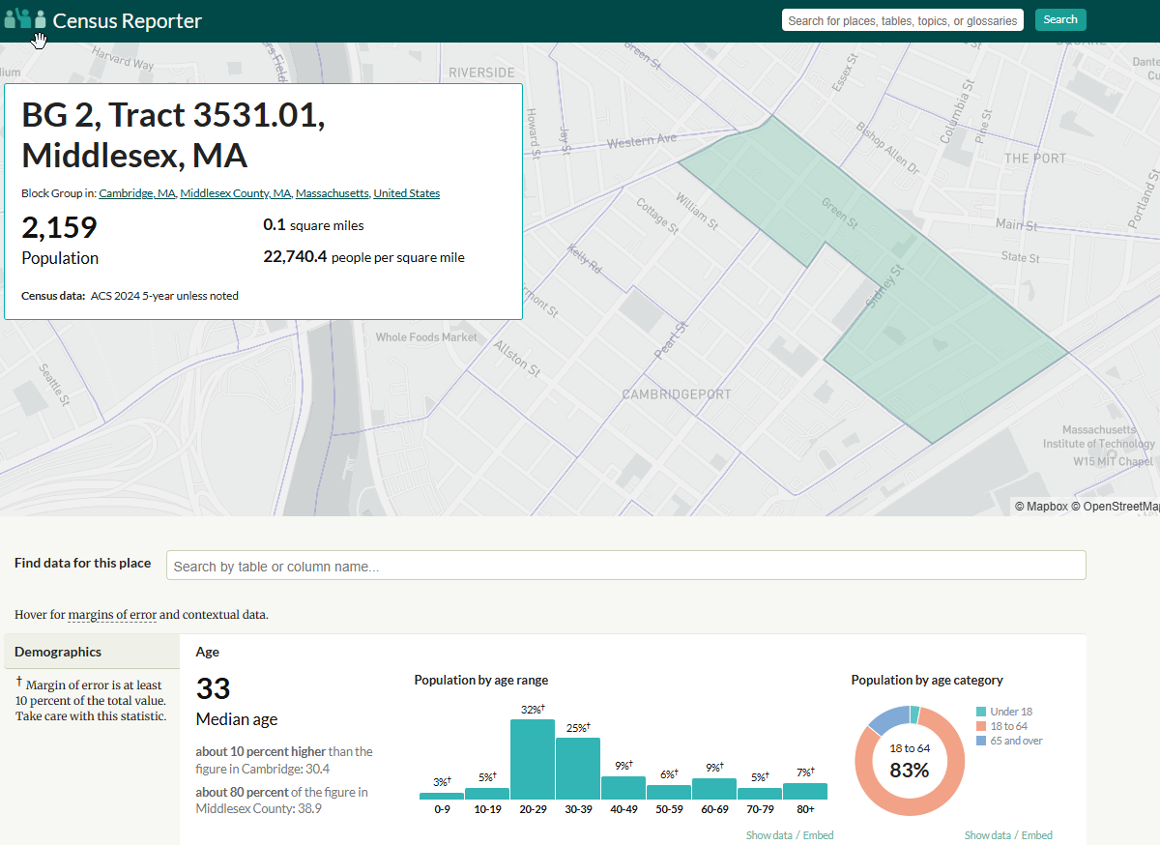
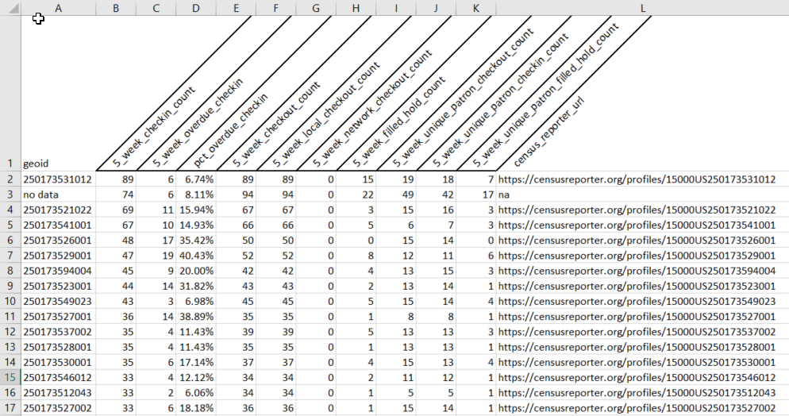
Which Patrons Are the Heaviest Users of Our Hotspots?
Notes:
With that data you can match your data to a Tigerline shapefile matching your area, available freely from the Census Bureau, or just click on one of the produced links to view the information for a particular region the Census Reporter site, which I love. The top area here happens to cover Central Square, which falls directly between the MIT and Harvard campuses and incidentally there’s a branch right in the center of that area, that’s also within a block of a major transit hub. Now the caveat with this is we only have access to a month of data because of our retention policies, but this is data that could be extracted and stored in order to accumulate data over time without compromising patron privacy.

Slide 14
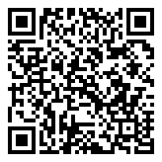
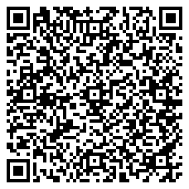
Which Patrons Are the Heaviest Users of Our Hotspots?
Geocoding Script
Transactions by Geography Query
Notes:
If you’re interested in digging into how we build these geography based reports the script used for geocoding our patrons records is available in our repo, as is the sql query used to build the report we were just viewing, though that one is a little Minuteman specific.

Slide 15
Which patron checked out a particular item, 2 checkouts ago?
Staff check in an item and are then informed the item was damaged by the prior patron
If 5 weeks have elapsed since that check in, that data is gone and the lpatron field now reflects this most recent transaction instead
Notes:
This question is one that comes down to addressing an occasion edge case at the circ desk where a staff member checks in an item, which overwrites the last patron field and later the item is reported as having been damaged, or missing a disk, or something like that.
Is it helpful to track down that former patron to address the damage. If it’s to track down a disc that might still be in the other patron’s dvd player…maybe. But is the rare time that comes up worth maintaining that data for every transaction for every patron long term…especially when staff with the ability/permissions to query it are limited…not particularly. At least for us as a somewhat privileged group of libraries that are fully fines free and more often than not struggle to spend down their materials budgets by the end of the fiscal year anyway. Give that patron a pass and just buy the replacement copy if demand warrants it.

Slide 16
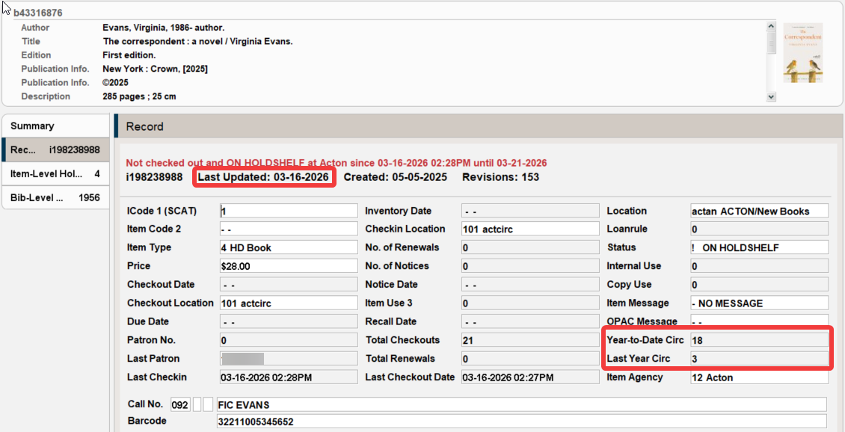
What was the most checked out title of 2025?
Our YTD and LYTD circ fields are fiscal year based
Notes:
Finally let’s look at the top question that we can’t fully answer and it’s something pretty ordinary on the surface, what are the top circulating titles from last year. Sierra has fields for tracking year to date and last year to date checkouts for each item…though if you withdraw a copy that data is of course lost. But we can’t use those fields for this purpose because our system configured to base those around the fiscal and not the calendar year as we need that data for annual fiscal year reporting.

Slide 17
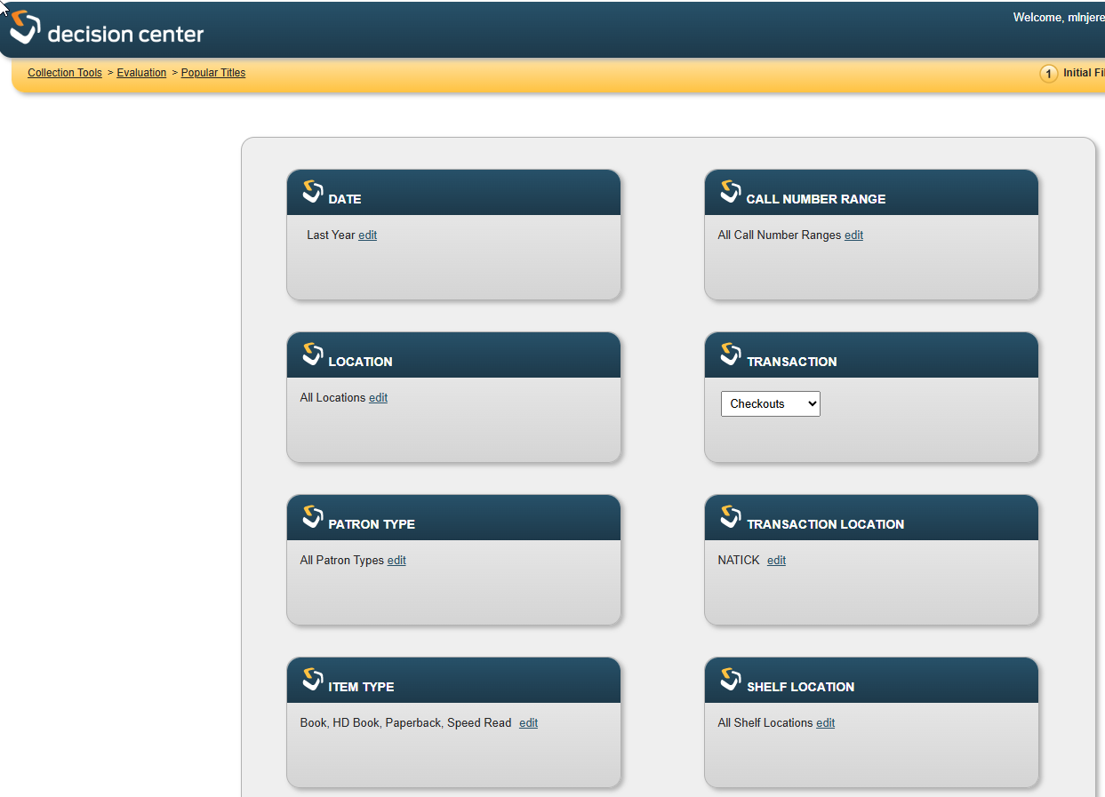
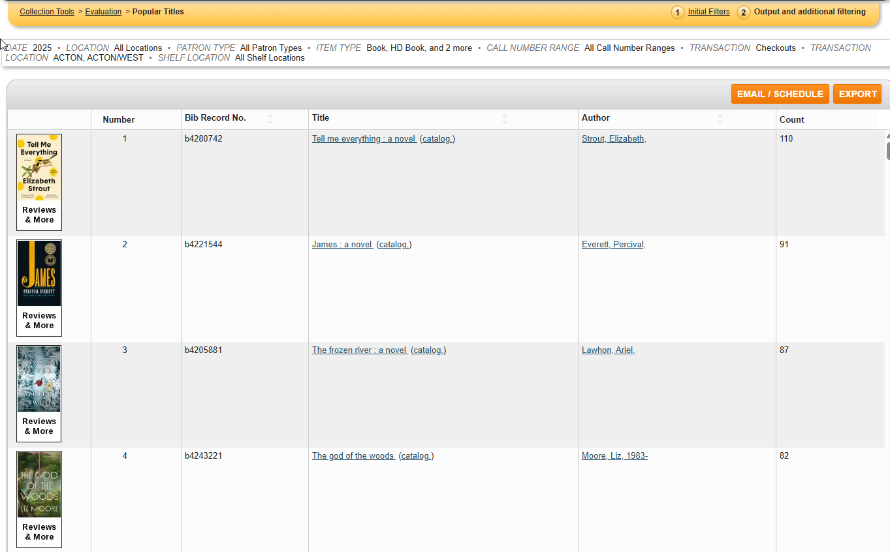
Imperfect Option
DC stores 3 years of data
It’s slow
It times out
It only returns the top 100
Notes:
There are a number of imperfect options that exist, which may be good enough, starting with Decision Center and the 3 years of transaction data it keeps without providing patron details beyond using a few fixed field options as filters. However, this report has problems, it’s ungodly slow, it regularly timesout without completing, and when it does work you only get the top 100 titles matching your filters, and if you weren’t careful with your filters most of those top 100 will be occupied by things like circulating tote bags and the Pokemon manga that is all on one serial record…accurate but not what you want…which goes to show that what checked out the most isn’t necessarily what you actually want anyway

Slide 18
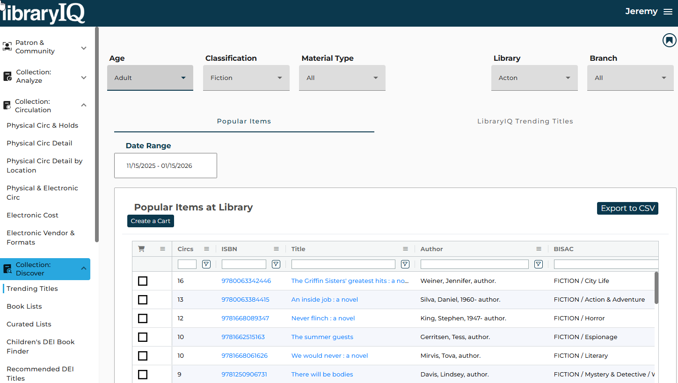
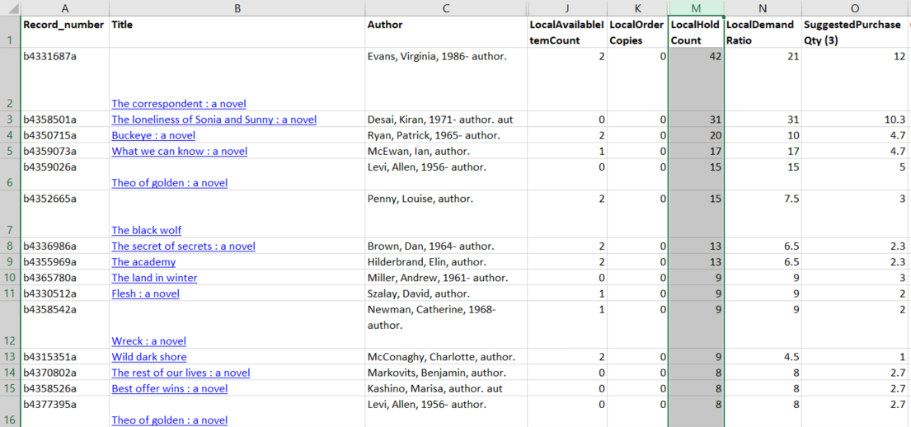
More Options
libraryIQ Trending Titles
Most circs of items in collection
Minuteman Purchase Alert
Outstanding holds for pickup location
Notes:
There are other close but not quite options that are somewhat readily available.
libraryIQ does store transaction history for a couple years, but as the tool is primarily focused on assessing your collection staff mostly can’t look at the trends involving other library’s materials that passed through their location. There’s one exception to that in there currently but it happens to work with item level details as opposed to title level rollups.
Our purchase alert is our take on the high demand holds report native to Sierra, but accounting for orders, consortia data, and just generally fancier. So it’s looking at unfilled holds to measure present demand which isn’t an exact match for best of the year but may still get you to that ballpark. In this case the top items on the list wound up being quite different, and yet both are valid alternate ways to explore what’s popular or trending, among many others. If you’re paying close attention, please note that all 3 of these produced different results for the top of the list. None are wrong, there just is not single correct path

Slide 19
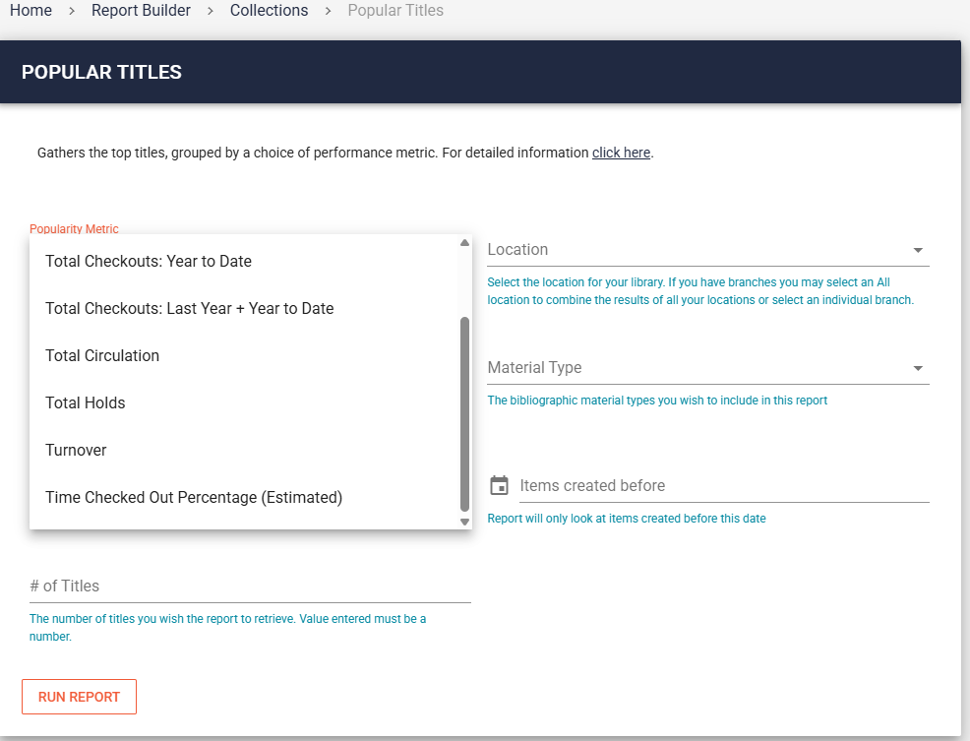
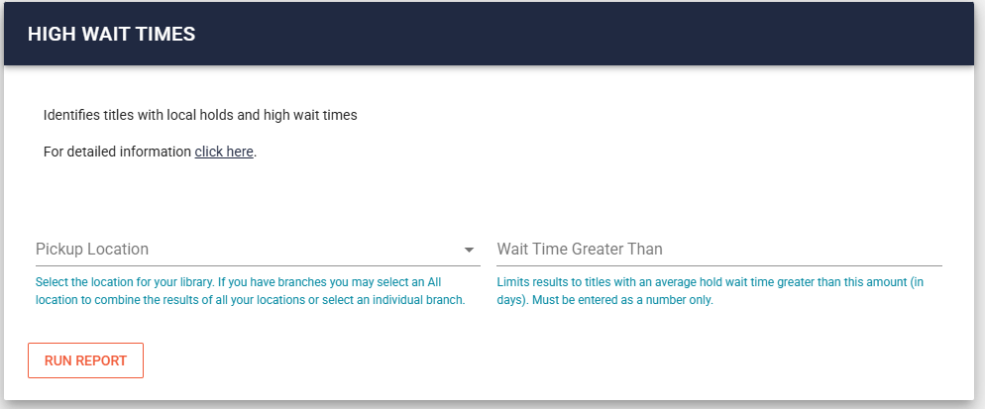
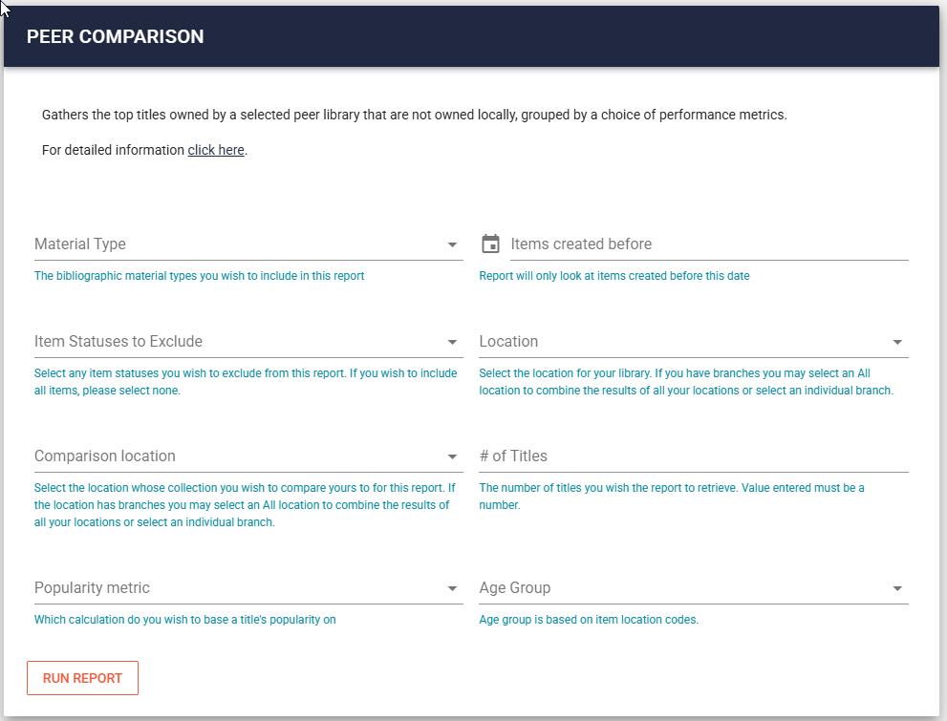
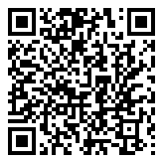
Even More Options
Notes:
This is from our canned reports site where we have a popular titles tool that will run a SQL query for staff based on the selected parameters. We have 8 different options available for how one might wish to define popularity, ranging from the straight forward (total circ, total holds, year to date checkouts) to the experimental (percent of time checked out based on an item’s age, the lifetime circ total and the avg loan period length for items sharing an itype based on current checkouts). We also have alt reports entirely to come at these sorts of questions from different approaches. What titles have high wait times, what’s popular at other libraries in the network, what titles have the most copies that are currently overdue
This shows how even without the precise data you may long for, with some creativity and advanced preparation you can still find ways to produce workable results that may provide meaningful information to fulfill your library’s needs.

Slide 20
Thank You!
Jeremy Goldstein
Minuteman Library Network
jgoldstein@minlib.net

